Slide 1
DATABASE MANAGEMENT SYSTEM

Slide 2
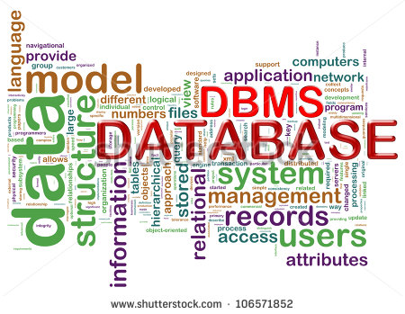
OVERVIEW
Database
DBMS
Applications
Flat Files
DBMS vs Flat File
Features of DBMS
Data Models

Slide 3
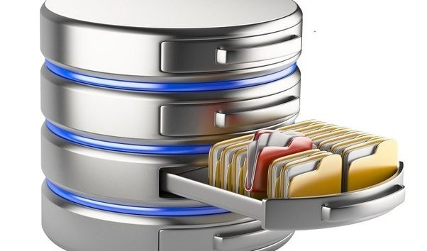
DATABASE
Database means a collection of logically related data.
Data means facts collected together for a reference or analysis.
Example: student names, student grades and transcripts at a university

Slide 4
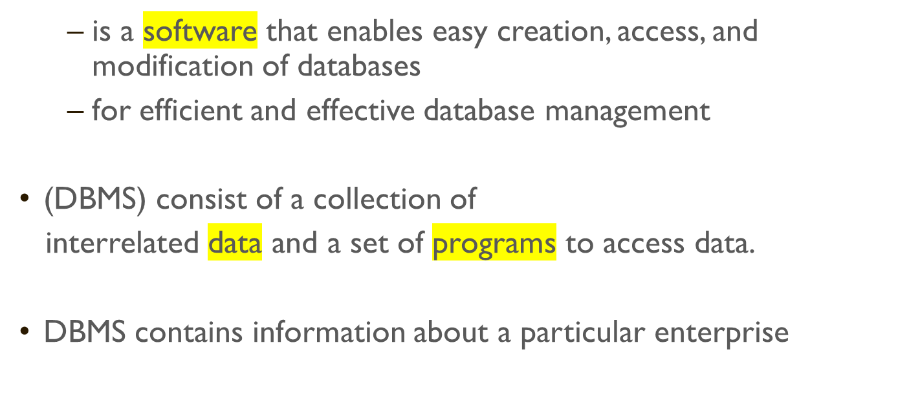
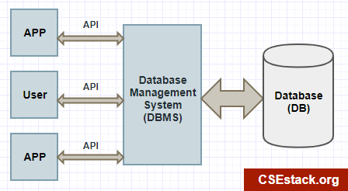
DATABASE MANAGEMENT SYSTEM (DBMS)

Slide 5
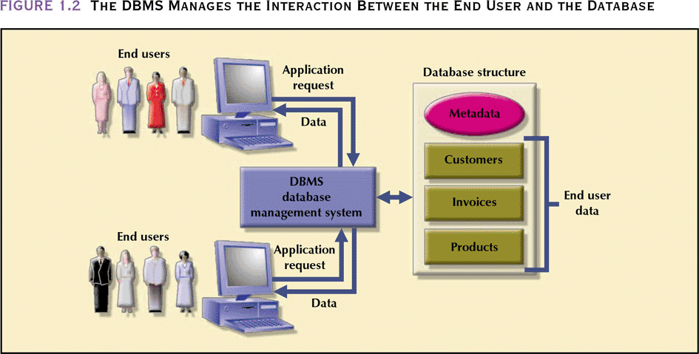
DATABASE MANAGEMENT SYSTEM
- manages interaction between end users and database

Slide 6
DATABASE APPLICATIONS
  Banking: all transactions
  Airlines: reservations, schedules
  Universities: registration, grades
  Sales: customers, products, purchases
  Manufacturing: production, inventory, orders, supply chain
  Human resources: employee records, salaries, tax deductions
Databases touch all aspects of our lives

Slide 7
FLAT FILES
A flat file is data held in a single file
Flat files are used to store:
  List of student marks
  List of movies.
  List of Bank Accounts
An Excel sheet or Notepad file can be used as a flat
file database,
with a column representing a field and
a row representing a record.
The data stored in one file cannot easily be linked to data stored in another file.
CPU4002

Slide 8
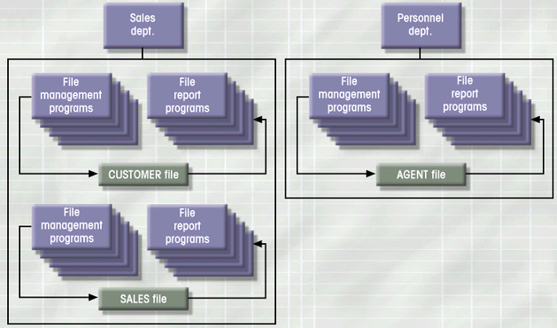
FILE SYSTEM: EXAMPLE
S511 Session 2, IU-SLIS

Slide 9
FILE SYSTEM: WEAKNESS
Weakness
  “Islands of data” in scattered file systems.
Problems
  Duplication
    same data may be stored in multiple files
  Inconsistency
    same data may be stored by different names in different format
  Rigidity
    requires customized programming to implement any changes
    cannot do ad-hoc queries
Implications
  Waste of space
  Data inaccuracies
  High overhead of data manipulation and maintenance
S511 Session 2, IU-SLIS

Slide 10
FILE SYSTEM: PROBLEM CASE
CUSTOMER file
AGENT file
SALES file
A_Name (15 char)
A_Name (20 char)
AGENT (20 char)
Carol Johnson
Carol T. Johnson
Carol J. Smith
- inconsistent field name, field size
- inconsistent data values
- data duplication
S511 Session 2, IU-SLIS

Slide 11
FILE SYSTEM DRAWBACKS
  Data redundancy and inconsistency
    Duplication of information in different files so potentially different values
    Wasted space and different formats for the same item.
  Data isolation — multiple files and formats
    Each program maintains its own set of data.
    Users of one program may be unaware of potentially useful data held by other programs.
  Difficulty in accessing data
    Need to write a new program to carry out each new task
  Integrity problems
    Integrity constraints (e.g. account balance > 500) become part of program code
    Hard to add new constraints or change existing ones

Slide 12
FILE SYSTEM DRAWBACKS(CONTD..)
  Atomicity of updates
    Failures may leave database in an inconsistent state with partial updates carried out
    E.g. transfer of funds from one account to another should either complete or not happen at all
  Concurrent access by multiple users
    Concurrent access is needed for performance
    Uncontrolled concurrent accesses can lead to inconsistencies
      E.g. two people reading a balance and updating it at the same time
  Security problems
Database systems offer solutions to all the above problems

Slide 13
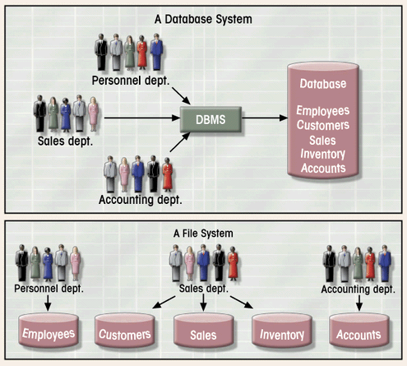
DATABASE SYSTEM VS. FILE SYSTEM
Database Systems: Design, Implementation, & Management: Rob & Coronel
S511 Session 2, IU-SLIS

Slide 14
DATABASE SYSTEM VS FLAT FILE
Data Independence
  structure of the database does not affect the programs which access the database
Redundancy Control
  data is not stored in several places in separate files
Data Consistency
  Since data is only stored once, no possibility of holding different data on different files (e.g. different prices for same product)
CPU4002

Slide 15
DATABASE SYSTEM VS FLAT FILE
Sharing of data among multiple users
  allowing a set of concurrent users to retrieve and to update the database
Security of data
  users can only view or update the parts they are authorised to access or change
Quality of management information
  information more useful as it is based on a single, comprehensive set of data
CPU4002

Slide 16
FEATURES OF DBMS
Features of DBMS are:
Minimum redundancy
Data integrity, consistency and accuracy
Provides high level of security
Permanent storage of data
Large and efficient data base maintenance

Slide 17
FOUNDATION DATA CONCEPTS
Abstract Concepts
Entity – person, place, object or event
– stored as a record or a table row
Example: Student, Patient, Employee
University, Company, Bank,
Book, Flight, Bird, Account,
Coding_Competition
Attribute – characteristic/feature specific of an entity
– stored as field or table column
Example: Student_ID, Patient_Name, Employee_Salary
University_Location, Company_YearFounded, Bank_Manager
Book_Price, Flight_Capacity, Bird_Noofwings, Account_Balance,
CC_no_of_participants

Slide 18
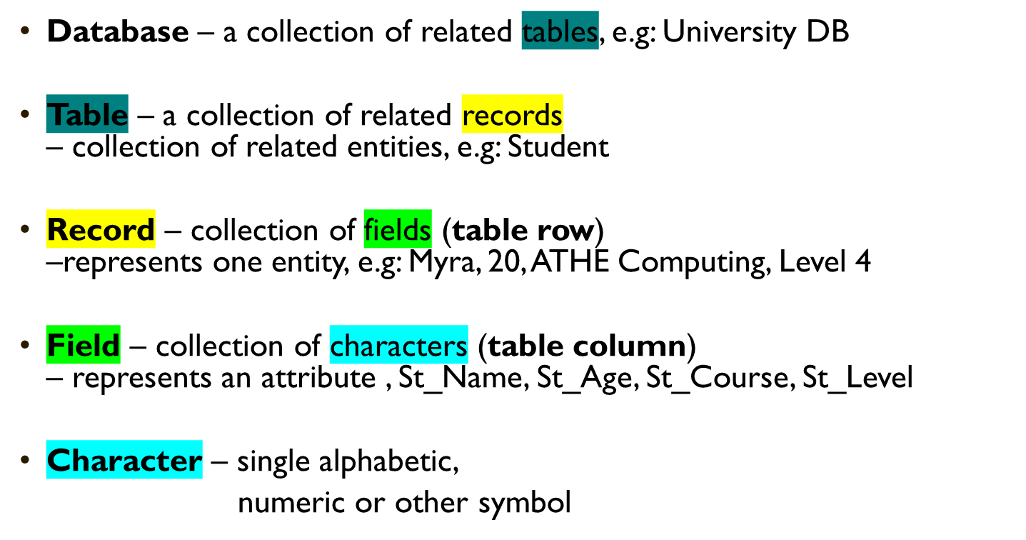
FOUNDATION DATA CONCEPTS(CONTD..)
Large
Small

Slide 19
ATTRIBUTE/FIELDS
Characters “P A R K E R” form a field/column, say Lastname
A field is an attribute of an entity
Last Name
Parker

Slide 20
ENTITY/RECORDS
A collection of fields form a record
A record is an entity
First Name
Peter
Last Name
Parker
Gender
Male
Weight
25

Slide 21
TABLES
A collection of records forms a table
A table is a group of related entities
First Name | Last Name | Gender | Age
Peter | Parker | M | 25
Mary | Jane | F | 22
Jackie | Chan | M | 45

Slide 22
DATABASES
0
A collection of tables form a database
A database can represent a single business or an entire market
Customer Table
Order Table
Product Table

Slide 23
DATABASES
0
But, databases are not just a bunch of tables
A database also includes relationships between the different tables
Orders
OID | CID | PID | Quantity
001 | 508 | 199 | 500,000
002 | 508 | 201 | 2
003 | 510 | 201 | 1
Customers
CID | FName | LName | Address
508 | Eric | Breimer | ...
509 | Andrew | Zych | ...
510 | Greg | Smith | ...
Products
PID | Description | Cost
199 | Soap | $45.99
200 | Tooth Paste | $2.58
201 | Hair Gel | $5.99

